Slide 1



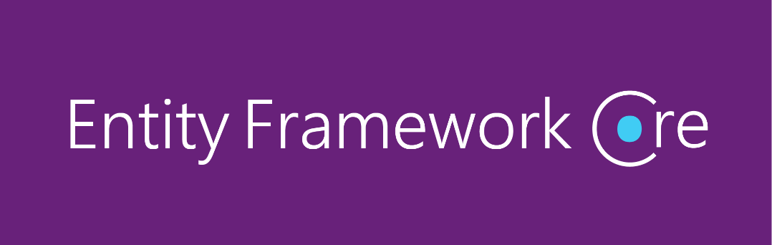


EF Core Code First
Entity Framework DB From Code,
OOP Introduction
Code
First
SoftUni Team
Technical Trainers
Software University
http://softuni.bg

Slide 2


Table of Contents
Code First model
EF Core Components
EF Core Configuration
Database Migrations

Slide 3
Questions
sli.do #CSharpDB

Slide 4
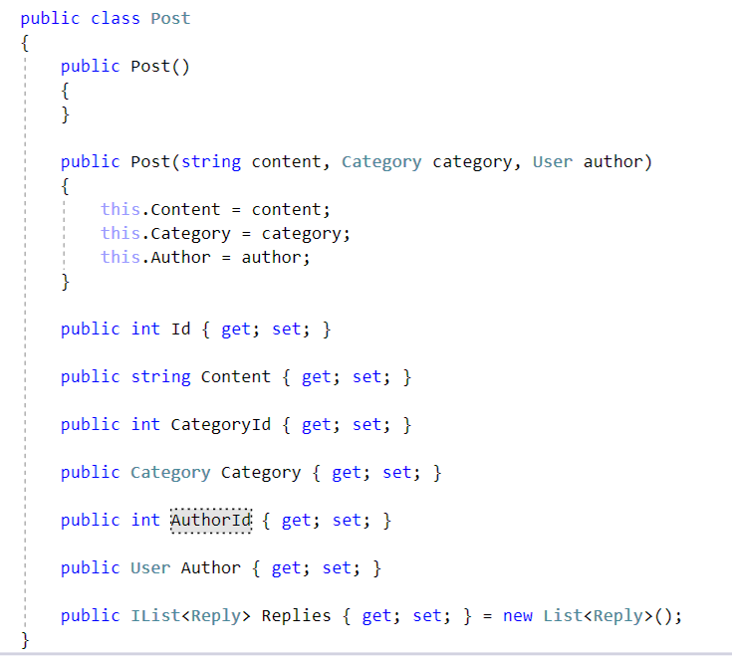
Code First Model
Motivation for Code First approach

Slide 5
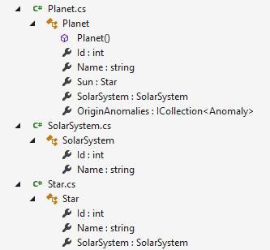
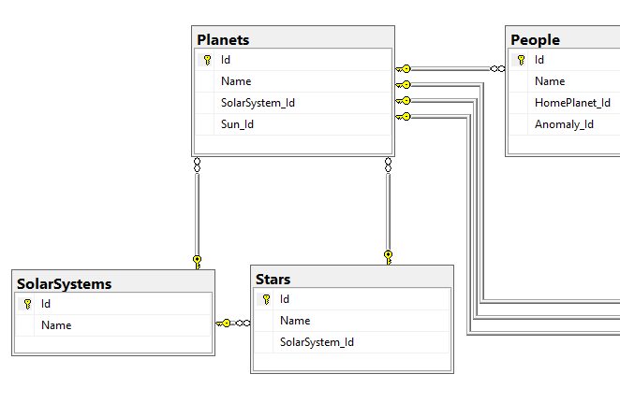
What is the Code First Model?
Code First means to write the .NET classes and let EF Core create the database from the mappings

Slide 6
Why Use Code First?
Write code without having to define mappings in XML or create database tables
Define objects in C# format
Enables database persistence with no configuration
Changes to code can be reflected (migrated) in the schema
Data Annotations or Fluent API describe properties
Key, Required, MinLength, etc.

Slide 7

EF Core Components
DbContext
Post
User
Overview of system objects

Slide 8
Domain Classes (Models)
Bunch of normal C# classes (POCO)
May contain navigation properties for table relationships
Recommended to be in a separate class library
public class PostAnswer
{
public int Id { get; set; }
public string Content { get; set; }
public int PostId { get; set; }
public Post Post { get; set; }
}
Primary key
Foreign key
Navigation property

Slide 9
Domain Classes (Models) (2)
Another example of domain class (model)
public class Post
{
public int Id { get; set; }
public string Content { get; set; }
public int AuthorId { get; set; }
public User Author { get; set; }
public IList<Reply> Replies { get; set; }
}
Navigation property
One-to-Many relation

Slide 10
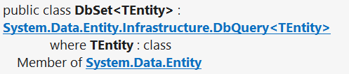
DbSet Type
Maps a collection of entities from a table
Set operations: Add, Attach, Remove, Find
DbContext contains multiple DbSet<T> properties
public DbSet<Post> Posts { get; set; }

Slide 11
The DbContext Class
Usually named after the database, inherits base class DbContext
e.g. BlogDbContext, ForumDbContext
Inherits from DbContext
Manages model classes using DbSet<T> type
Implements identity tracking, change tracking
Provides API for CRUD operations and LINQ-based data access
Recommended to be in a separate class library
Don't forget to reference the EF Core library + any providers
Use several DbContext if you have too much models

Slide 12
Defining DbContext Class – Example
EF Reference
using Microsoft.EntityFrameworkCore;
using CodeFirst.Data.Models;
public class ForumDbContext : DbContext
{
public DbSet<Category> Categories { get; set; }
public DbSet<Post> Posts { get; set; }
public DbSet<PostAnswer> PostAnswers { get; set; }
public DbSet<User> Users { get; set; }
}
Models Namespace

Slide 13
CRUD Operations with EF Code First
var db = new ForumDbContext();
var category = new Category { Name = "Database course" };
db.Categories.Add(category);
var post = new Post();
post.Title = "Homework Deadline";
post.Content = "Please extend the homework deadline";
post.Type = PostType.Normal;
post.Category = category;
post.Tags.Add(new Tag { Text = "homework" });
post.Tags.Add(new Tag { Text = "deadline" });
db.Posts.Add(post);
db.SaveChanges();

Slide 14
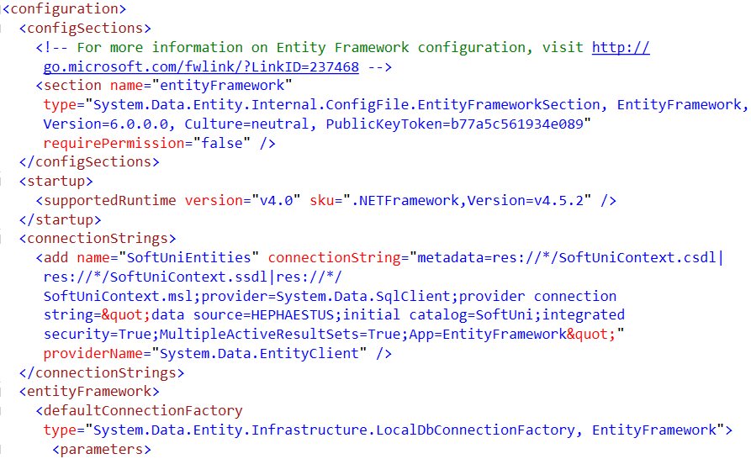

EF Core Configuration
NuGet Packages, Configuration

Slide 15
Code First with EF Core: Setup
To add EF Core support to a project in Visual Studio:
Install it from Package Manager Console
EF Core is modular – any data providers must be installed too
Install-Package Microsoft.EntityFrameworkCore
Install-Package Microsoft.EntityFrameworkCore.SqlServer

Slide 16
How to Connect to SQL Server?
One way to connect is to create a Configuration class with your connection string:
Then add the connection string in the OnConfiguring method in the DbContext class
public static class Configuration
{
public const string ConnectionString = "Server=.;Database=…;";
}
protected override void OnConfiguring(DbContextOptionsBuilder builder)
{
if (!builder.IsConfigured)
builder.UseSqlServer(Configuration.ConnectionString);
}

Slide 17
Fluent API
The OnModelCreating Method lets us use the Fluent API to describe our table relations to EF Core
protected override void OnModelCreating(ModelBuilder builder)
{
builder.Entity<Category>()
.HasMany(c => c.Posts)
.WithOne(p => p.Category);
builder.Entity<Post>()
.HasMany(p => p.Replies)
.WithOne(r => r.Post);
builder.Entity<User>()
.HasMany(u => u.Posts)
.WithOne(p => p.Author);
}

Slide 18
Database Connection Workflow
Database Exists?
Yes
Use Database
No
Create Database

Slide 19

Database Migrations

Slide 20
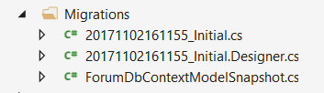
What are Database Migrations?
Updating database schema without losing data
Adding/dropping tables, columns, etc.
Migrations in EF Core keep their history
Entity Classes, DB Context versions are all preserved
Automatically generated

Slide 21
Migrations in EF Core
To use migrations in EF Core, we use the Add-Migration command from the Package Manager Console
To undo a migration, we use Remove-Migration
Commit changes to the database, using Update-Database
Add-Migration {MigrationName}
Remove-Migration
Update-Database

Slide 22
Summary
Code First increases productivity by centralizing maintenance
Classes represent real world objects with their properties and behaviour
Entity Framework Core uses data classes (POCOs) to represent DB objects
We can use Database Migrations to update our database without losing our data

Slide 23







EF Core Code First
https://softuni.bg/courses/databases-basics-ms-sql-server

Slide 24






SoftUni Diamond Partners

Slide 25






SoftUni Diamond Partners

Slide 26
License
This course (slides, examples, demos, videos, homework, etc.) is licensed under the "Creative Commons Attribution-NonCommercial-ShareAlike 4.0 International" license
Attribution: this work may contain portions from
"Databases" course by Telerik Academy under CC-BY-NC-SA license

Slide 27





Trainings @ Software University (SoftUni)
Software University – High-Quality Education, Profession and Job for Software Developers
softuni.bg
Software University Foundation
http://softuni.foundation/
Software University @ Facebook
facebook.com/SoftwareUniversity
Software University Forums
forum.softuni.bg

